Slide 1
The Impacts of Racism
Stage 4-6 LS

Slide 2
Learning Intention
To learn about what how racist behaviour can impact those who experience it. This lesson has a focus on understanding stereotypes and prejudice, as well as perspective taking and empathy.
We will do this through the following activities:
Quiz
Discussion
Sorting activity
Think, pair, share

Slide 3
This is a safe space
This is a safe place where no one will judge you for what you say or think. It's okay to make mistakes, but it's important to recognise and learn from them.
Let's talk about how we can respect each other while we learn together...
Notes:
Prompt students to share some ways that they can be respectful in this learning environment. Responses will be specific to different learning environments, but some could include:
Taking turns
Listening to one another
Not raising voices
Reading body signs
If you think a term or word will be hurtful, don't use it

Slide 4
Activity 01
Stereotypes & Prejudice

Slide 5
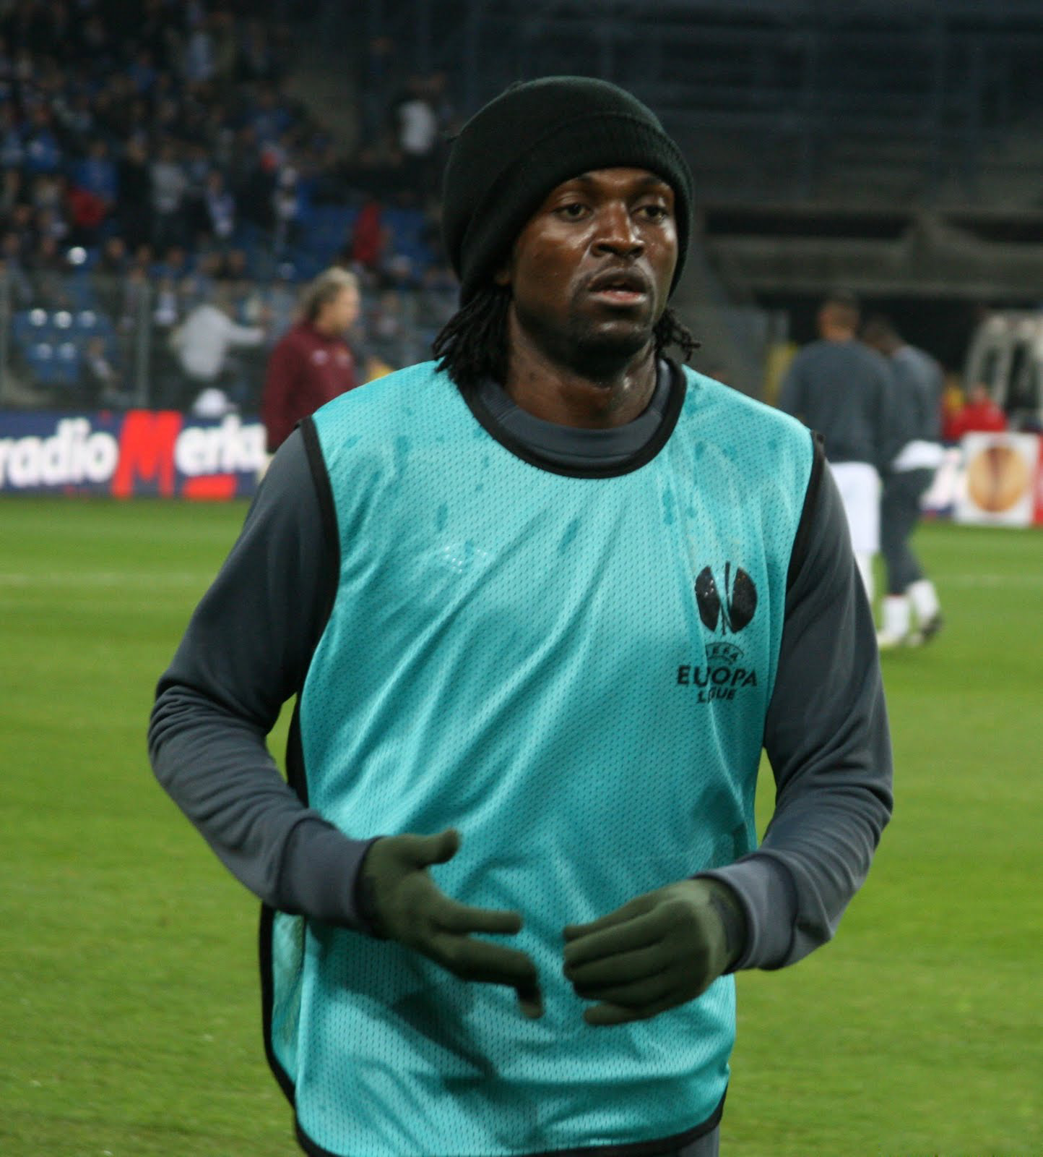
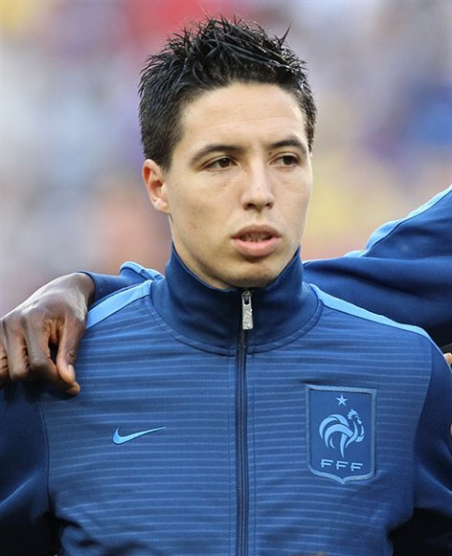
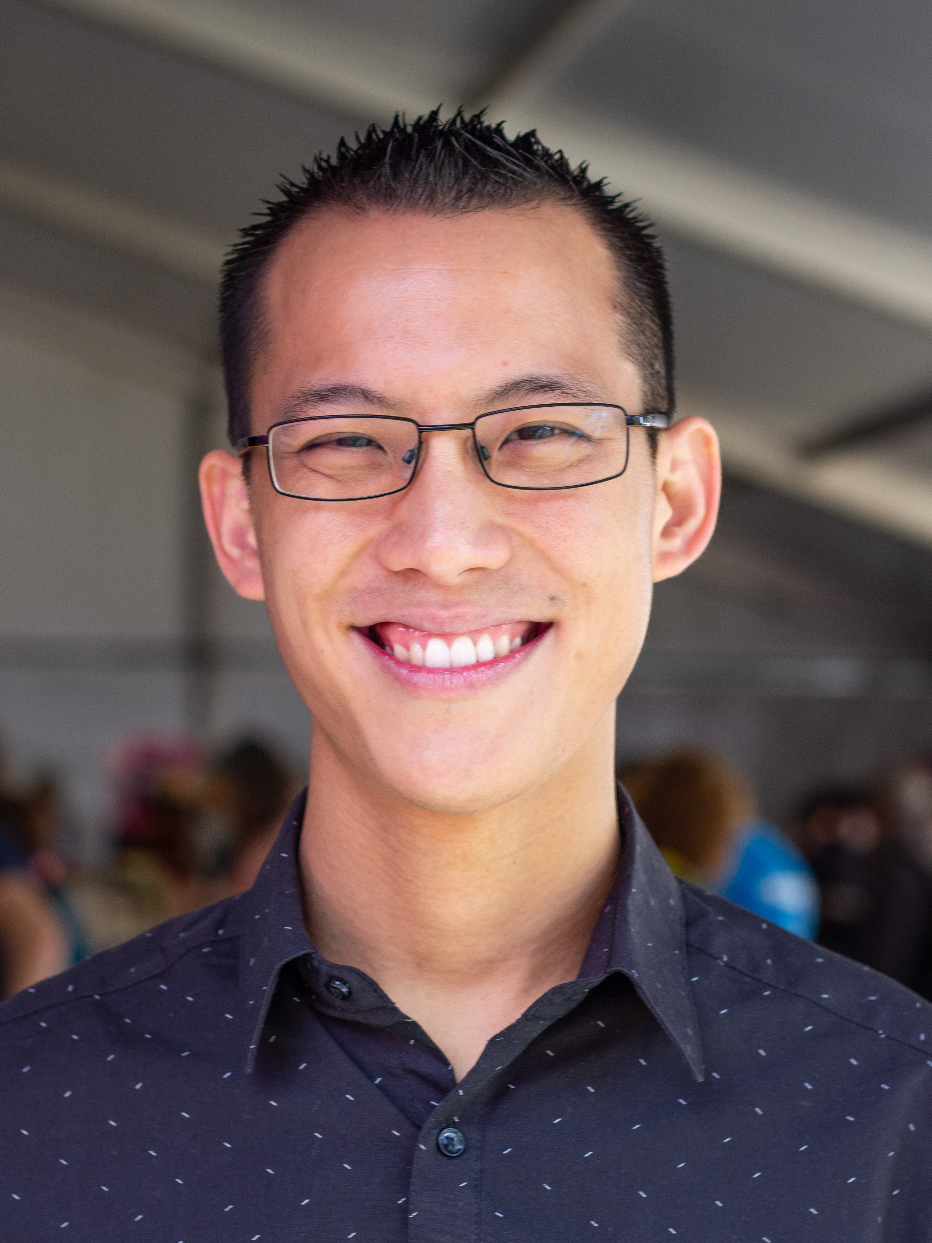
Stereotypes & Prejudice Quiz
1
2
3
4
"Moldova welcomes refugees fleeing Ukraine" by EU Civil Protection and Humanitarian Aid is licensed under CC BY 2.0.
This image has been cropped.
"Emmanuel Adebayor - Lech - Manchester 026" by Roger Gorączniak is licensed under CC BY 3.0.
"Samir Nasri Euro 2012" by Станислав Ведмидь/Stanislav Vedmid'/Stanisław Wiedmid' is licensed under CC BY-SA 3.0.
"Eddie Woo, February 2019 01 (cropped)" by Samuel Wiki is licensed under CC BY 4.0.
Muslim
Teacher
Refugee
Christian
Notes:
Answers:
Refugee: Olga is a refugee seeking asylum in Moldova.
Christian: Emmanuel Adebayor is a proud Christian and famous soccer player. He has played for Arsenal, Manchester City and Real Madrid.
Muslim: Samir Nasri is a proud Muslim and famous soccer player. He played for Uk and British teams Manchester City and Seville.
Teacher: Eddie Woo is a well-known Australian Maths teacher.
Discussion:
What answers surprised you the most? Why?
Are we good at judging people before we know them? Why?
Does anybody know what a stereotype is?
Do you think that stereotypes might have influenced our answers?
Define what a stereotype is: they are generalisations that don’t account for individual difference.
What kind of stereotypes exist about Australian people? E.g., Crocodile Dundee or Steve Irwin. Do we BBQ every day, wear Akubra hats, speak in slang, have blonde hair?
Finish the activity by discussing and emphasising that stereotypes are simplified, often exaggerated beliefs or ideas about a particular group of people based on characteristics such as race, ethnicity, gender, religion, or nationality.

Slide 6
Stereotypes & Prejudice
Stereotypes can lead to prejudice because when people accept stereotypes to be realistic, they can develop negative attitudes or biases towards the group being stereotyped.

Slide 7
Recognising and challenging stereotypes and prejudice is a critical step in addressing racism.

Slide 8
Activity 02
Feelings & Emotions

Slide 9
Feelings and Emotions
Notes:
Prepare students to explore perspective-taking exercises with a brainstorm on what feelings or emotions someone might experience if they are the victim of racist behaviour.
Start by re-capping what racist behaviour is from last lesson as one group in society believing they are better than other groups and treats them unfairly based on things like; the colour of their skin; the language they speak; the country they or their parents were born in; the food they eat; or the culture or religion they follow.
Use the following questions and points to prompt discussion and responses:
This or That questioning. E.g., would someone feel happy or sad if a classmate made jokes about the food they had for lunch? Would someone feel isolated or welcomed if they weren’t invited to play at lunch because of the language they speak?
How would you feel if someone treated you differently or unkindly?
Have you ever witnessed someone being treated unfairly because of their race? How did it make you feel?
How do you think someone might feel if they were excluded or left out of games, activities or conversations because of their race? How would you feel in that situation?
Focus on vocabulary such as “excluded”, “hurt”, “angry”, “confused”, “isolated”, “frustrated”, “embarrassed” in discussion and questioning.
Students can be invited to share their responses either verbally or by writing them on the whiteboard themselves.

Slide 10
How would you feel if...
This Photo by Unknown author is licensed under CC BY-NC.

Slide 11
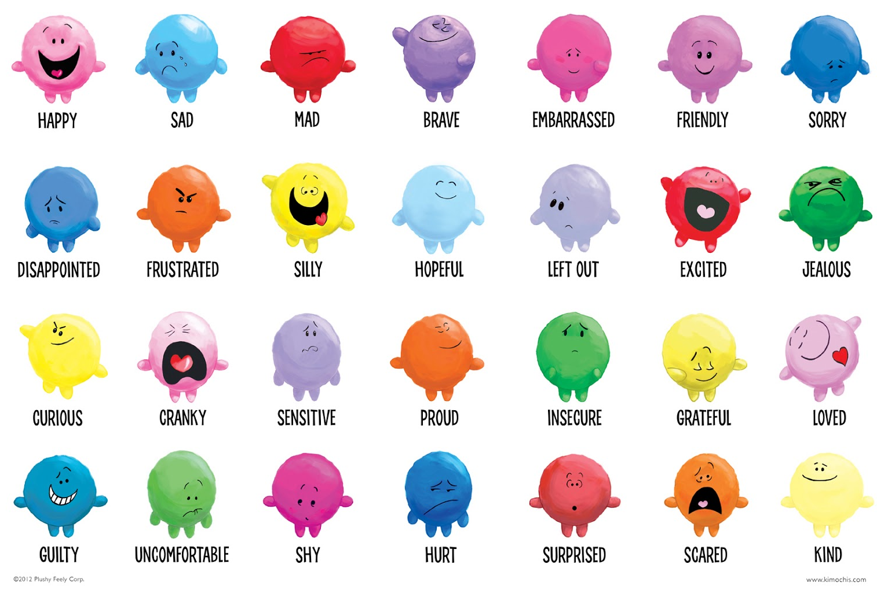
How would you feel if...
This Photo by Unknown author is licensed under CC BY-NC.

Slide 12
Activity 03
Cause & Effect Sorting Activity

Slide 13
Activity 04
Think, Pair, Share

Slide 14
Scenario 1: The Classroom
Jayden is a new student to year 9, he has moved to the area and doesn't know anyone. Farukh has been asked by the year advisor to show him around and help him settle in this week. Farukh is a popular student who plays basketball every lunchtime with the senior students.
Jayden has started mocking Farukh's name, making exaggerated pronunciations and whispered insults, trying to embarrass him.
Farukh was selected to help Jayden, because he is a trustworthy and reliable student, however, he has become a target of Jayden's bullying. His friends have stayed silent when they see or hear Jayden's behaviours, they are scared of becoming targets too.
This Photo by Unknown author is licensed under CC BY.
Notes:
After reading, check student understanding of vocabulary which may be unfamiliar. Such as; exaggerated, insults, mocking etc.

Slide 15
Think, Pair, Share
How would you feel if you were Farukh?
How might Farukh react?
How could you respond to the situation to support Farukh as one of his peers?
Notes:
Additional probing questions/strategies:
Refer to the emotions visuals on slides 4 or 5 to select appropriate emotions.
This or That questioning. E.g. Would he feel happy or sad?; calm or angry?; frustrated or hurt? Etc.
Why might the individual react the way they do? What factors might be behind the emotions they are experiencing?
Would laughing/joining in with the bully be a good way to support the individual? How about ignoring? What about blocking ears?

Slide 16
Scenario 2: At Lunchtime
During lunchtime in the school library, a small group of friends are playing cards. Among them was Ella. Ella grew up in a household where her family mostly speak Tagalog, and while she is a confident English speaker, she sometimes gets stuck reading English.
It was Ella's turn to draw a card and read the scenario. She felt like she did a good job the first time, but as the game progressed, Ella sometimes stumbled over the pronunciation of certain words. Her friends, including Jake, who was sitting across from her, couldn't understand why she struggled with some of the English words.
Jake became frustrated with her mistakes and corrected her loudly every time. He began to mimic her pronunciation of the words and told her "It's not that hard". Ella felt her face go red with embarrassment.
Notes:
After reading, check student understanding of vocabulary which may be unfamiliar. Such as; Tagalog, scenario, frustrated, mimic, pronunciation, etc.

Slide 17
Think, Pair, Share
How would you feel if you were Ella?
How might Ella react?
How could you respond to the situation to support Ella as one of her peers?
Notes:
Additional probing questions/strategies:
Refer to the emotions visuals on slides 4 or 5 to select appropriate emotions.
This or That questioning. E.g. Would he feel happy or sad?; calm or angry?; frustrated or hurt? Etc.
Why might the individual react the way they do? What factors might be behind the emotions they are experiencing?
Would laughing/joining in with the bully be a good way to support the individual? How about ignoring? What about blocking ears?

Slide 18
Scenario 3: Online
This exchange illustrates cyber racism on a social media platform where two students make derogatory comments about a new teacher based on her background and language skills, implying that she doesn't belong because she's not a native English speaker.
BrightStar12 : Hey, did you see that new teacher we have for Science? She's from another country. #ForeignerAlert
CoolKid24: Yeah, I noticed. Her English is kinda weird though. LOL. #NotFromHere
BrightStar12: Seriously, it's like she's speaking gibberish. Why can't she learn English properly before coming here? #SpeakProperly
CoolKid24: Right? She should fit in or get out. We don't need people like her messing up our country. #SpeakEnglish
Notes:
After reading, check student understanding of vocabulary which may be unfamiliar. Such as; derogatory etc.

Slide 19
Think, Pair, Share
How would you feel if you were the person being spoken about?
How could you respond to the situation if you witnessed this behaviour online?
Would your response be different if it was a friend being spoken about, rather than a teacher?
Notes:
Additional probing questions/strategies:
Refer to the emotions visuals on slides 4 or 5 to select appropriate emotions.
This or That questioning. E.g. Would he feel happy or sad?; calm or angry?; frustrated or hurt? Etc.
Why might the individual react the way they do? What factors might be behind the emotions they are experiencing?
Would laughing/joining in with the bully be a good way to support the individual? How about ignoring? What about blocking ears?

Slide 20
End of Lesson Two

