Slide 1

OPEN IN DESKTOP APP
This will enable full functionality of the template.
CHOOSE A SLIDE STYLE FROM
  Home tab
  New Slide
  Choose layout
  If layout goes awry, select Reset
  TEXT
  There are 5 levels of formatted text available.
  Please move between text levels using the increase/decrease button on the menu above.
  CHANGE SLIDE BACKGROUND/COLOUR
  Design Menu
  Format Background
  Select colour from palette OR
  Picture or Texture Fill
  Find image
  REPLACE IMAGE IN SHAPE OR ON PAGE
  Right click on image
  Change Picture
  Select your image
  OR
  Delete the image
  Click on icon
  Find the new image
  TO REPOSITION IMAGE WITHIN SHAPE
  Click on image
  Picture Format menu
  Click on Crop button dropdown
  To fit the whole image inside select FIT
  To use only a portion select FILL then crop, move or resize image to show properly within shape.
  ADD/CHANGE FOOTER
  Insert Menu
  Header & Footer
  Tick to activate/Untick to remove
  Change text
Media Literacy and Racism
  Learning intention:
    Analyse media for bias, stereotypes, and race representations.
  Success criteria:
    Recognise bias and stereotypes in media texts.
    Explain race representation in media.
    Describe how language, images, and editing influence representations.
    Provide a judgement on the fairness of the representation with evidence.
Stage 4 and 5 Humanities and English
General Capabilities
  Critical and Creative Thinking
  Intercultural understanding
  Ethical understanding
Notes:
Carefully explain the learning intentions and success criteria and let the class know how many lessons they will be doing this activity for.

Slide 2


MEDIA EXPOSURE
Notes:
Discussion Points
Have a discussion in groups or with a partner about the different types of media we may be exposed to daily.
- Streaming and video content- You tube Netflix, TV shows, movies
- Social Media -Tik Tok, Insta, Snapchat, Facebook, influencers, memes (mention social media restrictions for under 16s in Australia, first in the world)
- Gaming and online communities -Fortnite, Roblox, Discord, in game chats and livestreams
- News and online articles- News websites and apps, headlines shred, podcasts and short news clips
-Music and podcasts.
This discussion will help students see how constant and varied their exposure to the media is.
This is also an opportunity. to discuss issues of how media engages and hooks people in to achieve likes, clicks, shares and ongoing engagement with their platform.

Slide 3
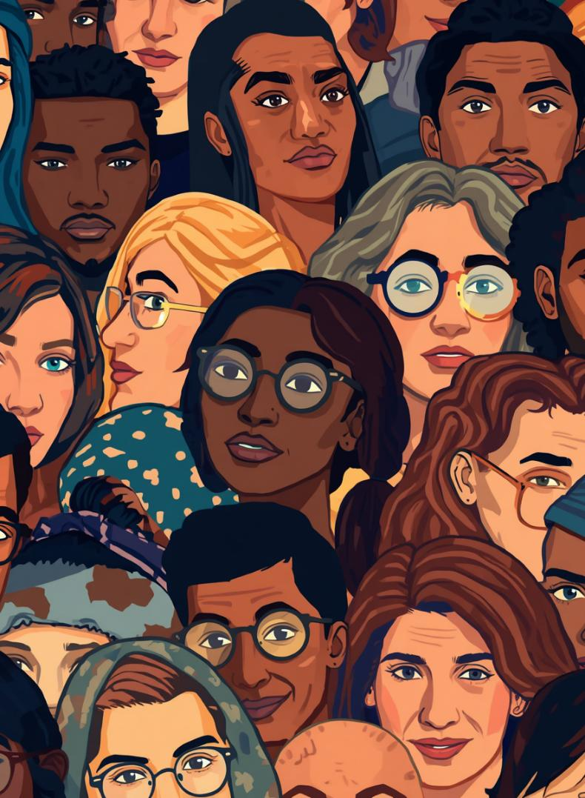


OPEN IN DESKTOP APP
This will enable full functionality of the template.
CHOOSE A SLIDE STYLE FROM
  Home tab
  New Slide
  Choose layout
  If layout goes awry, select Reset
  TEXT
  There are 5 levels of formatted text available.
  Please move between text levels using the increase/decrease button on the menu above.
  CHANGE SLIDE BACKGROUND/COLOUR
  Design Menu
  Format Background
  Select colour from palette OR
  Picture or Texture Fill
  Find image
  REPLACE IMAGE IN SHAPE OR ON PAGE
  Right click on image
  Change Picture
  Select your image
  OR
  Delete the image
  Click on icon
  Find the new image
  TO REPOSITION IMAGE WITHIN SHAPE
  Click on image
  Picture Format menu
  Click on Crop button dropdown
  To fit the whole image inside select FIT
  To use only a portion select FILL then crop, move or resize image to show properly within shape.
  ADD/CHANGE FOOTER
  Insert Menu
  Header & Footer
  Tick to activate/Untick to remove
  Change text
What is a Stereoptype?
A stereotype is a simplified and often unfair belief about a group of people.
These ideas are usually:
  overgeneralised (applied to everyone in the group)
  repeated in media and society
  not based on individual reality
  often linked to race, culture, or identity
  usually negative.
In the media, stereotypes are often used because they are quick, recognisable shortcuts. Regardless of intention they can be harmful.
Activity : Discuss with a partner how these shortcuts and stereotypes can be harmful.
Notes:
Discussion point
- Ask students to think about some stereotypes they may know of. These should not be shared, students can just take a reflective moment to think about them.
- As the teacher you may want to provide some stereotypes that will not offend anyone in the class.
- This would be a good time to discuss how harmful stereotypes can be.
Ensure you approach any work on anti-racism with a trauma aware lens. Set clear class expectations at the beginning of each lesson and regularly check on the wellbeing of all students in the classroom.

Slide 4
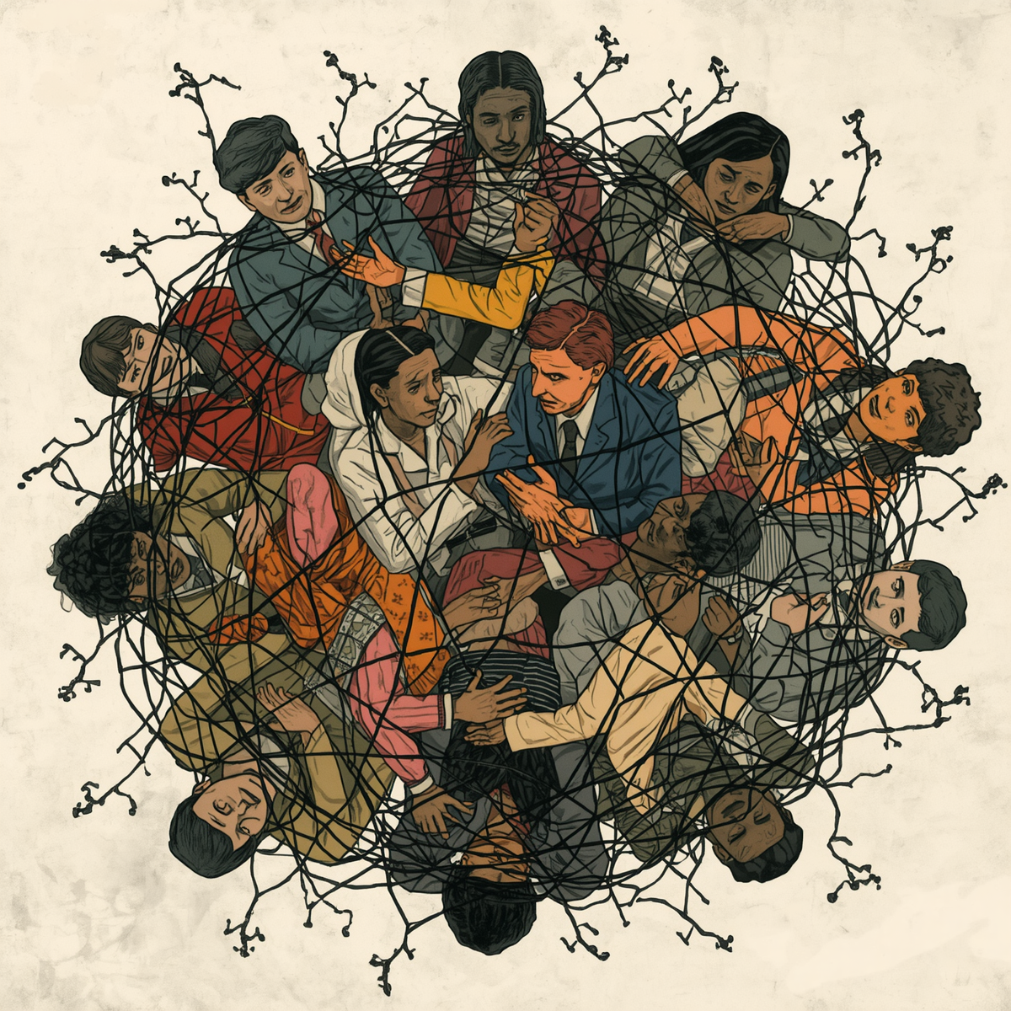
OPEN IN DESKTOP APP
This will enable full functionality of the template.
CHOOSE A SLIDE STYLE FROM
  Home tab
  New Slide
  Choose layout
  If layout goes awry, select Reset
  TEXT
  There are 5 levels of formatted text available.
  Please move between text levels using the increase/decrease button on the menu above.
  CHANGE SLIDE BACKGROUND/COLOUR
  Design Menu
  Format Background
  Select colour from palette OR
  Picture or Texture Fill
  Find image
  REPLACE IMAGE IN SHAPE OR ON PAGE
  Right click on image
  Change Picture
  Select your image
  OR
  Delete the image
  Click on icon
  Find the new image
  TO REPOSITION IMAGE WITHIN SHAPE
  Click on image
  Picture Format menu
  Click on Crop button dropdown
  To fit the whole image inside select FIT
  To use only a portion select FILL then crop, move or resize image to show properly within shape.
  ADD/CHANGE FOOTER
  Insert Menu
  Header & Footer
  Tick to activate/Untick to remove
  Change text
Why do stereotypes matter?
Stereotypes in media often relate to race, culture, or identity.
Stereotypes are not just “opinions”, they can shape:
  how people are treated
  expectations placed on groups
  opportunities people receive.
Over time, stereotypes can:
  reinforce racism and discrimination
  influence how individuals see themselves (identity + belonging)
  normalise biased or unfair representations.

Slide 5
Stereotypical Images
Notes:
Add some images to this page around stereotypes.
Ensure the images you use for discussion are appropriate for your school context and do not perpetuate existing negative stereotypes.
Examples could come from current popular culture movies, TV shows or books.
Discussion points
Can something be: "just entertainment” and still be harmful?
Why do you think these stereotypes were accepted at the time they were created?
Given that most stereotypes are negative why do you think they were created in the first place?
What impact do you think these stereotypes will have on individuals and society?
Have stereotypes presented in children's cartoons, movies and media been removed or have they just changed over time?
How might these representations shape understanding of race?

Slide 6
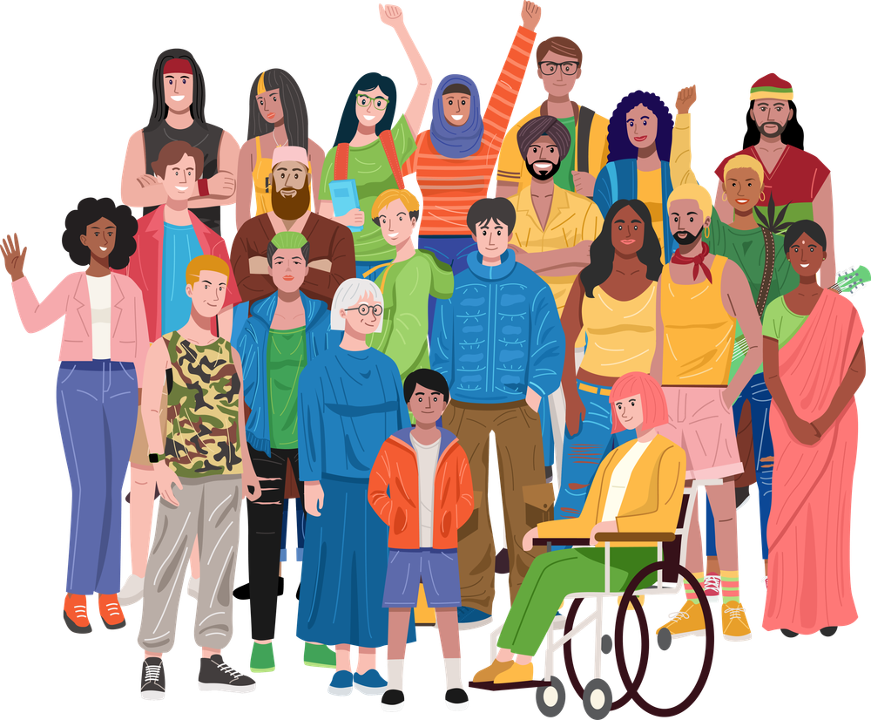

Partner Activity
Discuss news stories from this year that are important to:
your local community
You
the world
Notes:
With a partner, discuss different news stories from this year.
This activity will get students thinking about what is happening in their micro and macro world at the current time.
Discussion Activity
Come together as a class and discuss some of these news stories. Were their similarities and differences between what the students came up with?

Slide 7
Continuum Activity
We are exploring how different people interpret media and how perspectives can vary.
As you read each statement move to the position that best reflects your opinion.
There is no “correct” position - what matters is how well you can justify your thinking.
STRONGLY AGREE
STRONGLY DISAGREE
Notes:
You will need to set your classroom up so that students can stand in a line from strongly agree to strongly disagree. This could be a good activity to do outdoors.
As you provide each statement you may want to challenge and question the positions students take on the continuum.
Classroom discussion may lead to students changing their minds and moving.
You may be asked to share your reasoning with the class.
You may be asked to respond to or challenge another viewpoint.
You are allowed to move positions if your thinking changes.
Remind students to respect all opinions : you are critiquing ideas, not people.
Use evidence and examples where possible.
Listen actively to others.
Be open to changing your perspective

Slide 8
The media presents news fairly and accurately.

Slide 9
Most news articles are based on facts, not opinions.

Slide 10
Journalists try to be unbiased.

Slide 11
Headlines accurately reflect the full story.

Slide 12
If it’s published by a major news company, it can be trusted.

Slide 13
The media often represents some groups more negatively than others.

Slide 14
The way a story is written can influence how we feel about people.

Slide 15
Leaving out information can be just as powerful as including it.

Slide 16
Media stories can create stereotypes without being obviously racist.

Slide 17
Some groups are rarely given a voice in the media.

Slide 18
The same event can be made to look completely different depending on how it is reported.

Slide 19
Media influences what society sees as “normal.”

Slide 20
The media can shape public opinion more than facts do.

Slide 21
Emotional language is used to influence readers.

Slide 22
The media decides what issues are important.

Slide 23
It is possible for an article to be factual but still biased.

Slide 24
Readers are responsible for questioning the media.

Slide 25
People are more likely to believe news that matches their existing views.

Slide 26
Bias in media is sometimes unintentional.

Slide 27
The media reflects society more than it shapes it.

Slide 28
Media reporting can contribute to racism.

Slide 29
News stories can make communities feel unsafe even when there is no real danger.

Slide 30
Some media outlets prioritise attention over accuracy.

Slide 31
The media has too much power in shaping how we see different groups.

Slide 32
Without critical thinking, people can be easily influenced by the media.

Slide 33
Closing Disussions
If we all stood in different places, what does that tell us about media?
  Why might people interpret the same story differently?
  How can media contribute to division or racism?
  What does this tell us about truth in media?

Slide 34

Voice and Division
We are flooded with information. This information is framed to make us feel and react in a particular way. It can also attempt to make us feel a particular way about a group of people based on culture, ethnicity, religion, sexuality, language or gender. Social media can give everyone a voice, but it is also designed to push people to react quickly instead of thinking things through.
DISCUSSION: Why can being first to share information be more influential than being accurate, and what impact can this have on perceptions of groups?

Slide 35
.
“ How do we actually break down media?”
We don’t just read - we question.
We look at what’s included AND what’s missing.
We think about who benefits.

Slide 36
OPEN IN DESKTOP APP
This will enable full functionality of the template.
CHOOSE A SLIDE STYLE FROM
  Home tab
  New Slide
  Choose layout
  If layout goes awry, select Reset
  TEXT
  There are 5 levels of formatted text available.
  Please move between text levels using the increase/decrease button on the menu above.
  CHANGE SLIDE BACKGROUND/COLOUR
  Design Menu
  Format Background
  Select colour from palette OR
  Picture or Texture Fill
  Find image
  REPLACE IMAGE IN SHAPE OR ON PAGE
  Right click on image
  Change Picture
  Select your image
  OR
  Delete the image
  Click on icon
  Find the new image
  TO REPOSITION IMAGE WITHIN SHAPE
  Click on image
  Picture Format menu
  Click on Crop button dropdown
  To fit the whole image inside select FIT
  To use only a portion select FILL then crop, move or resize image to show properly within shape.
  ADD/CHANGE FOOTER
  Insert Menu
  Header & Footer
  Tick to activate/Untick to remove
  Change text
PRUCOMA - Analysing media
🟣 P – Purpose : Why was this created?
Inform, persuade, entertain?
🔵 R – Representation: How are people or groups shown?
Positive, negative, stereotyped?
🟢 U – Usefulness: How reliable is it?
Evidence? Sources? Facts?
🟡 C – Context: What is happening at the time?
Social, political, cultural factors?
🔴 O – Omission: What is missing?
Whose voices are not included?
⚫ M – Motive: Why was it created?
Who benefits?
⚪ A – Audience: Who is it for?
How are they being influenced?
29
Notes:
This may look similar to the TOMACPRU acronym used in history lessons.
PRUCOMA for media literacy changes the O from origin to omission and the R from reliability to Representation.
Reliability of the source should be discussed in general in the purpose and motive sections.

Slide 37
Spot the Bias
.
Headline A
Headline B
A group of teenagers gathered in a local park last night, causing disruption to nearby residents. Police were called after reports of loud noise and anti-social behaviour.
A group of local teenagers spent time together in a park last night. Some residents reported noise concerns, and police attended to ensure the situation remained calm.
Pair activity
With the person next to you, read both versions.
They are reporting the same situation, but something feels different.
Your job is to work out how and why.
Notes:
Students working in pairs read the headline and attempt the partner activity.
Ensure you have carefully reviewed this activity and delete or change anything that may be problematic or too personal for your unique setting.

Slide 38
Spot the Bias
.
Headline A
Headline B
Police are investigating a group of young men of Middle Eastern appearance following an incident at a shopping centre.
Police are investigating a group of young men following an incident at a shopping centre. No further details have been confirmed.
Pair activity
With the person next to you, read both versions.
They are reporting the same situation, but something feels different.
Your job is to work out how and why.
Notes:
Students working in pairs read the headline and attempt the pair activity questions.
Ensure you have carefully reviewed this activity and delete or change anything that may be problematic or too personal for your unique setting.

Slide 39
Spot the Bias
.
Headline A
Headline B
The suburb has recently welcomed many new families from diverse backgrounds, contributing to a growing and vibrant community.
A large number of new migrant families have moved into the suburb, leading to concerns about overcrowding and pressure on local services.
Pair activity
With the person next to you, read both versions.
They are reporting the same situation, but something feels different.
Your job is to work out how and why.
Notes:
Students working in pairs read the headline and attempt the pair activity questions.
Ensure you have carefully reviewed this activity and delete or change anything that may be problematic or too personal for your unique setting.

Slide 40
Spot the Bias
.
Headline A
Headline B
Police responded to reports of disorderly behaviour involving a group of Aboriginal youths in the town centre late last night.
Police responded to reports of a disturbance involving a group of young people in the town centre late last night.
Pair activity
With the person next to you, read both versions.
They are reporting the same situation, but something feels different.
Your job is to work out how and why.
Notes:
Students working in pairs read the headline and attempt the pair activity questions.
Ensure you have carefully reviewed this activity and delete or change anything that may be problematic or too personal for your unique setting.

Slide 41
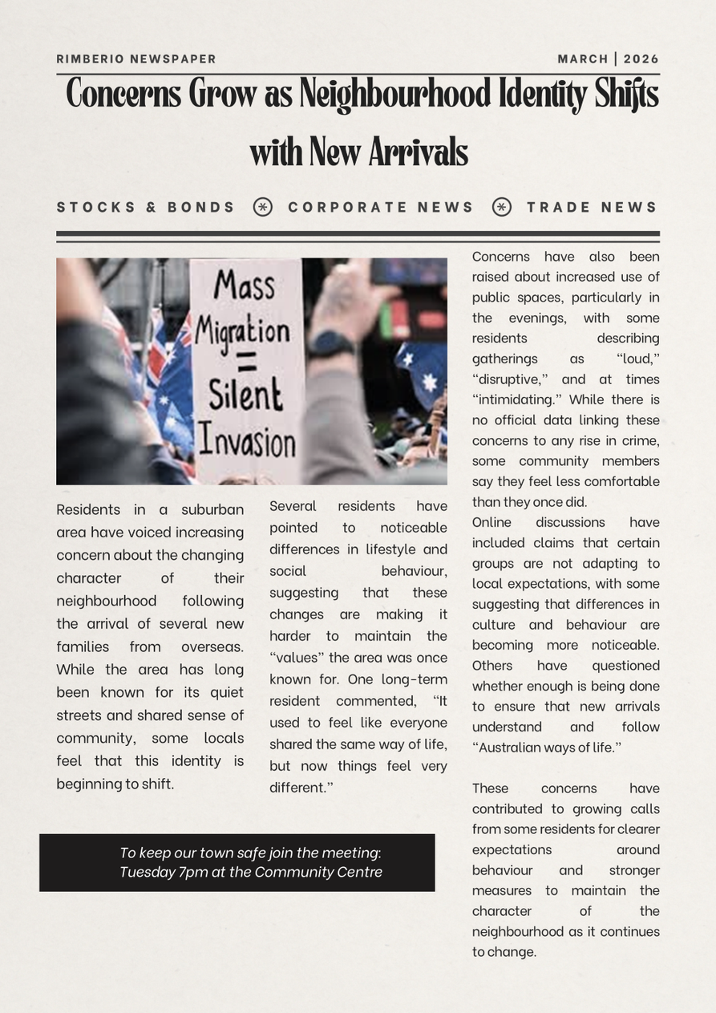
Article 1
🟣 P – Purpose Why was this created?
Inform, persuade, entertain?
🔵 R – Representation How are people or groups shown?
Positive, negative, stereotyped?
🟢 U – Usefulness How reliable is it?
Evidence? Sources? Facts?
🟡 C – Context What is happening at the time?
Social, political, cultural factors?
🔴 O – Omission What is missing?
Whose voices are not included?
⚫ M – Motive Why was it created?
Who benefits?
⚪ A – Audience Who is it for?
How are they being influenced?
Notes:
This article is available with a worksheet. Students could do one article as a class then attempt Article 2 and 3 in pairs or individually
🔵 Purpose
1.What is the main purpose of this article? (inform, persuade, entertain)
2.What is the article trying to make the reader think or feel?
🔵 Representation
1.How are people or groups represented in this article?
2.Are they shown positively, negatively, or in a stereotypical way?
3.What words or descriptions influence this representation?
🟢 Usefulness
1.How reliable is this article?
2. Does it include evidence, statistics, or expert opinions?
3.Is anything presented as fact without evidence?
🟡 Context
1.What is happening in society at the time this article was written?
2.Why might this issue be in the news right now?
🔴 Omission
1.What information is missing from this article?
2.Whose voices or perspectives are not included?
3.How might the story change if those voices were included?
⚫ Motive
1.Why might this article have been created?
2.Who benefits from the way this story is presented?
⚪ Audience
1.Who is the intended audience?
2.How is the reader being influenced (language, tone, assumptions)?
Follow up questions
a)How does this article shape the reader’s understanding of the issue?
b)What assumptions does the article make about the reader?
c)What message is the audience meant to take away?
d)Can this article contribute to stereotypes? How?
e)Can media be biased without being obviously racist? Explain
f)How might this article impact how people view certain groups?
g)Is the issue presented as a “problem”? Who is positioned as responsible?
h)Has analysing this article changed your perspective? How?
i)What will you do differently when reading media in the future?
j)What is this article trying to make me think, feel, or believe

Slide 42
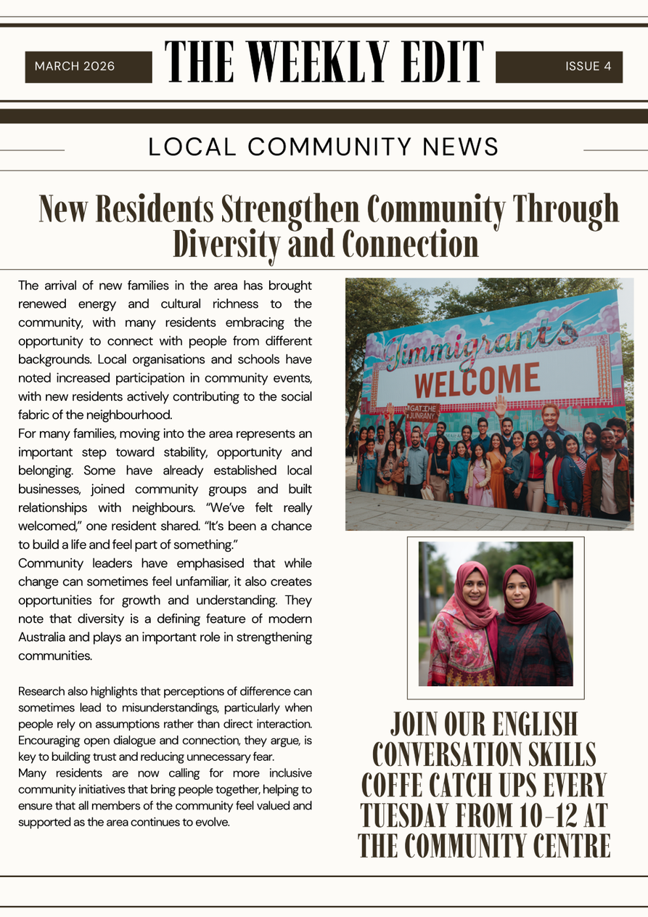
Article 2
🟣 P – Purpose Why was this created?
Inform, persuade, entertain?
🔵 R – Representation How are people or groups shown?
Positive, negative, stereotyped?
🟢 U – Usefulness How reliable is it?
Evidence? Sources? Facts?
🟡 C – Context What is happening at the time?
Social, political, cultural factors?
🔴 O – Omission What is missing?
Whose voices are not included?
⚫ M – Motive Why was it created?
Who benefits?
⚪ A – Audience Who is it for?
How are they being influenced?
Notes:
This article is available with a worksheet. Students could do one article as a class then attempt Article 2 and 3 in pairs or individually
🔵 Purpose
1.What is the main purpose of this article? (inform, persuade, entertain)
2.What is the article trying to make the reader think or feel?
🔵 Representation
1.How are people or groups represented in this article?
2.Are they shown positively, negatively, or in a stereotypical way?
3.What words or descriptions influence this representation?
🟢 Usefulness
1.How reliable is this article?
2. Does it include evidence, statistics, or expert opinions?
3.Is anything presented as fact without evidence?
🟡 Context
1.What is happening in society at the time this article was written?
2.Why might this issue be in the news right now?
🔴 Omission
1.What information is missing from this article?
2.Whose voices or perspectives are not included?
3.How might the story change if those voices were included?
⚫ Motive
1.Why might this article have been created?
2.Who benefits from the way this story is presented?
⚪ Audience
1.Who is the intended audience?
2.How is the reader being influenced (language, tone, assumptions)?
Follow up questions
a)How does this article shape the reader’s understanding of the issue?
b)What assumptions does the article make about the reader?
c)What message is the audience meant to take away?
d)Can this article contribute to stereotypes? How?
e)Can media be biased without being obviously racist? Explain
f)How might this article impact how people view certain groups?
g)Is the issue presented as a “problem”? Who is positioned as responsible?
h)Has analysing this article changed your perspective? How?
i)What will you do differently when reading media in the future?
j)What is this article trying to make me think, feel, or believe

Slide 43
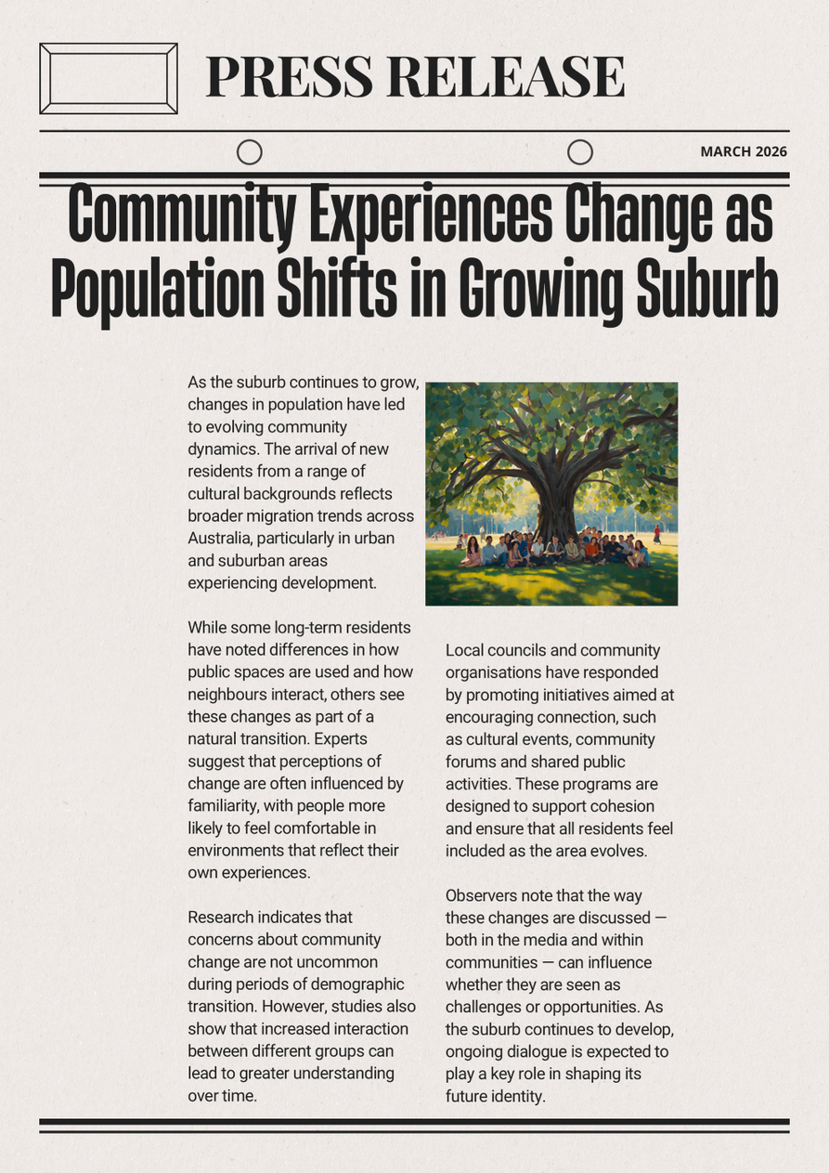
Article 3
🟣 P – Purpose Why was this created?
Inform, persuade, entertain?
🔵 R – Representation How are people or groups shown?
Positive, negative, stereotyped?
🟢 U – Usefulness How reliable is it?
Evidence? Sources? Facts?
🟡 C – Context What is happening at the time?
Social, political, cultural factors?
🔴 O – Omission What is missing?
Whose voices are not included?
⚫ M – Motive Why was it created?
Who benefits?
⚪ A – Audience Who is it for?
How are they being influenced?
Notes:
This article is available with a worksheet. Students could do one article as a class then attempt Article 2 and 3 in pairs or individually
🔵 Purpose
1.What is the main purpose of this article? (inform, persuade, entertain)
2.What is the article trying to make the reader think or feel?
🔵 Representation
1.How are people or groups represented in this article?
2.Are they shown positively, negatively, or in a stereotypical way?
3.What words or descriptions influence this representation?
🟢 Usefulness
1.How reliable is this article?
2. Does it include evidence, statistics, or expert opinions?
3.Is anything presented as fact without evidence?
🟡 Context
1.What is happening in society at the time this article was written?
2.Why might this issue be in the news right now?
🔴 Omission
1.What information is missing from this article?
2.Whose voices or perspectives are not included?
3.How might the story change if those voices were included?
⚫ Motive
1.Why might this article have been created?
2.Who benefits from the way this story is presented?
⚪ Audience
1.Who is the intended audience?
2.How is the reader being influenced (language, tone, assumptions)?
Follow up questions
a)How does this article shape the reader’s understanding of the issue?
b)What assumptions does the article make about the reader?
c)What message is the audience meant to take away?
d)Can this article contribute to stereotypes? How?
e)Can media be biased without being obviously racist? Explain
f)How might this article impact how people view certain groups?
g)Is the issue presented as a “problem”? Who is positioned as responsible?
h)Has analysing this article changed your perspective? How?
i)What will you do differently when reading media in the future?
j)What is this article trying to make me think, feel, or believe?

Slide 44
Individual research task:
You are now the researcher. Your job is to find a media article that allows you to APPLY PRUCOMA.
Suggested search topics:
  “immigration Australia community change”
  “new migrants suburb Australia”
  “cultural diversity neighbourhood Australia”
  “community concerns population growth Australia”
You must choose an article that:
✅ Is about a real social issue (not entertainment)
✅ Includes people or groups being represented
✅ Has some form of bias or perspective
✅ Is at least 3-5 paragraphs long
Your challenge:
“Find two articles on the same issue with different perspectives.”
Notes:
After doing your own research, do you trust media more, less, or differently?”

Slide 45
“Anyone can read an article. Critical thinkers question it.”
Notes:
What does this statement mean to you?

Slide 46
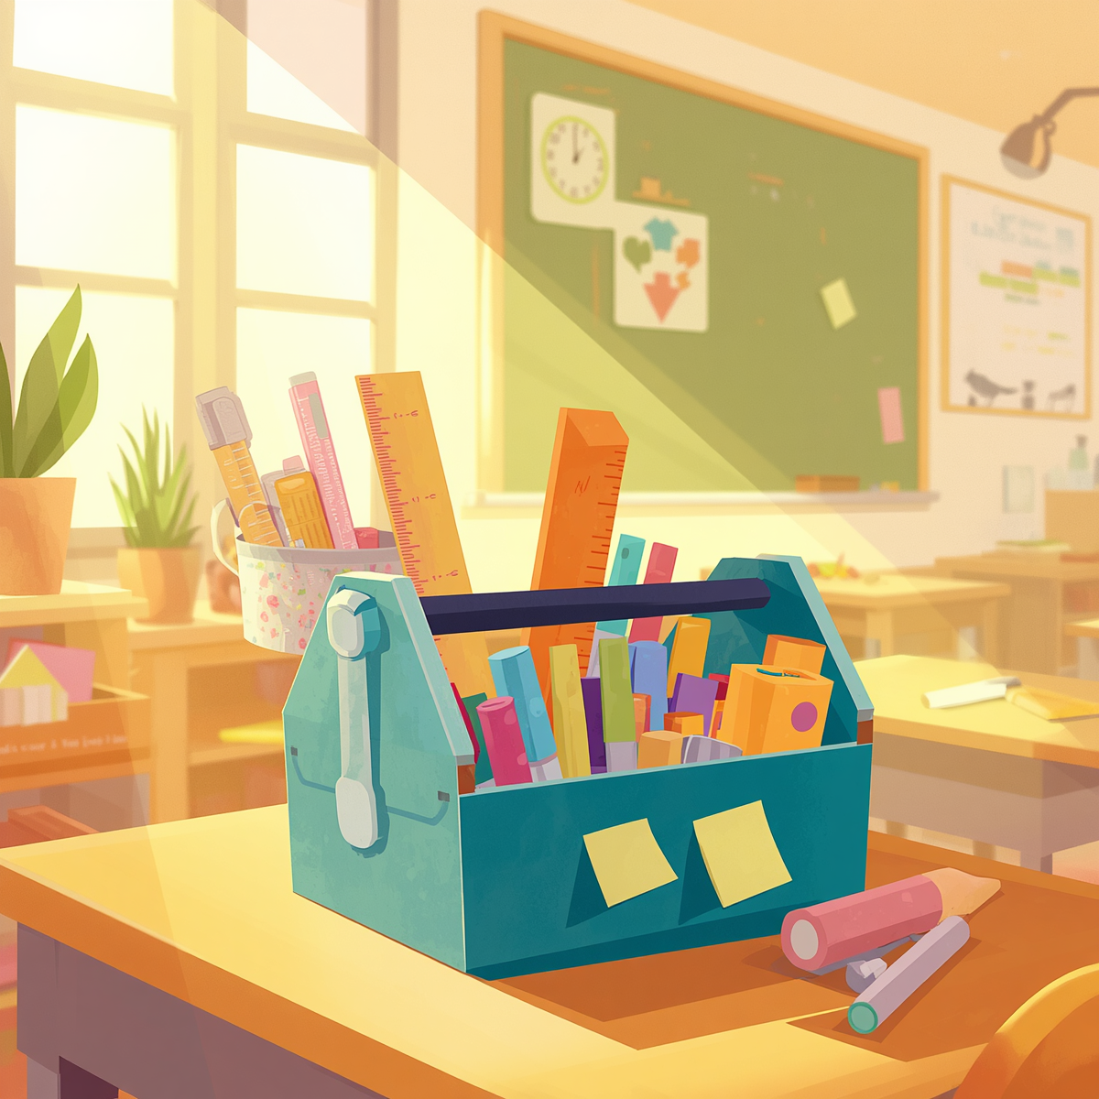
OPEN IN DESKTOP APP
This will enable full functionality of the template.
CHOOSE A SLIDE STYLE FROM
  Home tab
  New Slide
  Choose layout
  If layout goes awry, select Reset
  TEXT
  There are 5 levels of formatted text available.
  Please move between text levels using the increase/decrease button on the menu above.
  CHANGE SLIDE BACKGROUND/COLOUR
  Design Menu
  Format Background
  Select colour from palette OR
  Picture or Texture Fill
  Find image
  REPLACE IMAGE IN SHAPE OR ON PAGE
  Right click on image
  Change Picture
  Select your image
  OR
  Delete the image
  Click on icon
  Find the new image
  TO REPOSITION IMAGE WITHIN SHAPE
  Click on image
  Picture Format menu
  Click on Crop button dropdown
  To fit the whole image inside select FIT
  To use only a portion select FILL then crop, move or resize image to show properly within shape.
  ADD/CHANGE FOOTER
  Insert Menu
  Header & Footer
  Tick to activate/Untick to remove
  Change text
Additional Resources
  Racism. No Way! -is a national anti-racism education website that is managed by the NSW Department of Education on behalf of all Australian schools. The content aims to assist teachers to deliver anti-racism education within the school environment.
  Australian Human Rights Commission - a collection of resources that work to promote and protect human rights in Australia
Anti Racism Campaign -There’s nothing casual about racism
Race Discrimination
  ABC Education Media Literacy resources - a collection of vies and resources designed to teach young people about media literacy, fake news, fact checking an critical thinking.
  #Pledge to Pause - Verified is a United Nations initiative, in collaboration with Purpose, to cut through the noise around global crises and deliver critical fact-based advice and information.

